Slide 1

Toxic Comment Classification Using Natural Language Processing
Presented by: V.Madhumitha and R.Aswini

Slide 2



Project Overview: Tackling Online Toxicity
This project aims to automatically classify online comments as either 'Toxic' or 'Non-Toxic' using Natural Language Processing (NLP) techniques. Social media platforms often struggle with moderating offensive content; this system provides a real-time solution.
Real-time Classification
Python & Streamlit
Enhancing Moderation
Developed with a user-friendly web interface for interaction.
Assists platforms in maintaining healthier online communities.
Processes text data to instantly categorise comments.

Slide 3

Why Automated Toxicity Detection Matters
Online platforms are frequently plagued by abusive comments, which can severely damage community engagement and user experience. Automating the detection of such content is crucial for efficient content management and fostering a positive online environment.
Identifies harmful content automatically.
Reduces the burden on human moderators.
Applies text preprocessing, vectorisation, and classification.

Slide 4
Project Objectives: Building a Robust NLP System
01
02
03
Text Preprocessing
Feature Engineering
Comment Classification
Clean, tokenize, and lemmatise raw text data for analysis.
Convert text into numerical features using TF-IDF vectorisation.
Categorise comments as 'Toxic' or 'Non-Toxic' using machine learning.
04
05
Web Application Development
Batch Analysis
Create a Streamlit interface for real-time analysis and user interaction.
Enable simultaneous analysis of multiple comments.

Slide 5
Key Tools and Technologies Utilised
Python
Primary programming language for development.
Pandas
Efficient handling and manipulation of dataframes.
NLTK
Text preprocessing functionalities (tokenisation, lemmatisation).
Scikit-learn
TF-IDF vectorisation and Logistic Regression classification.
Streamlit
Building the interactive web interface.
Joblib
Saving and loading trained NLP models for deployment.

Slide 6

The Dataset: Fueling Our Classification Model
Our model was trained on the toxic_comments.csv dataset, a comprehensive collection of comments vital for distinguishing toxic from non-toxic language.
Dataset Name: toxic_comments.csv
Key Columns:
  comment_text: The raw text content of each comment.
  toxic: A binary label (1 for Toxic, 0 for Non-Toxic).
Content: Thousands of diverse comments, encompassing both positive and negative examples.

Slide 7
Essential Text Preprocessing Steps in NLP
Transforming raw text into a machine-readable format is crucial for accurate classification. Our pipeline involves several key steps:
Lowercasing
Character Removal
Tokenisation
Ensures uniformity by converting all text to lowercase.
Filters out special characters, retaining only letters and spaces.
Breaks down sentences into individual words or 'tokens'.
Lemmatisation
TF-IDF Vectorisation
Reduces words to their base or root forms (e.g., 'running' becomes 'run').
Converts processed text into numerical vectors, reflecting word importance.

Slide 8
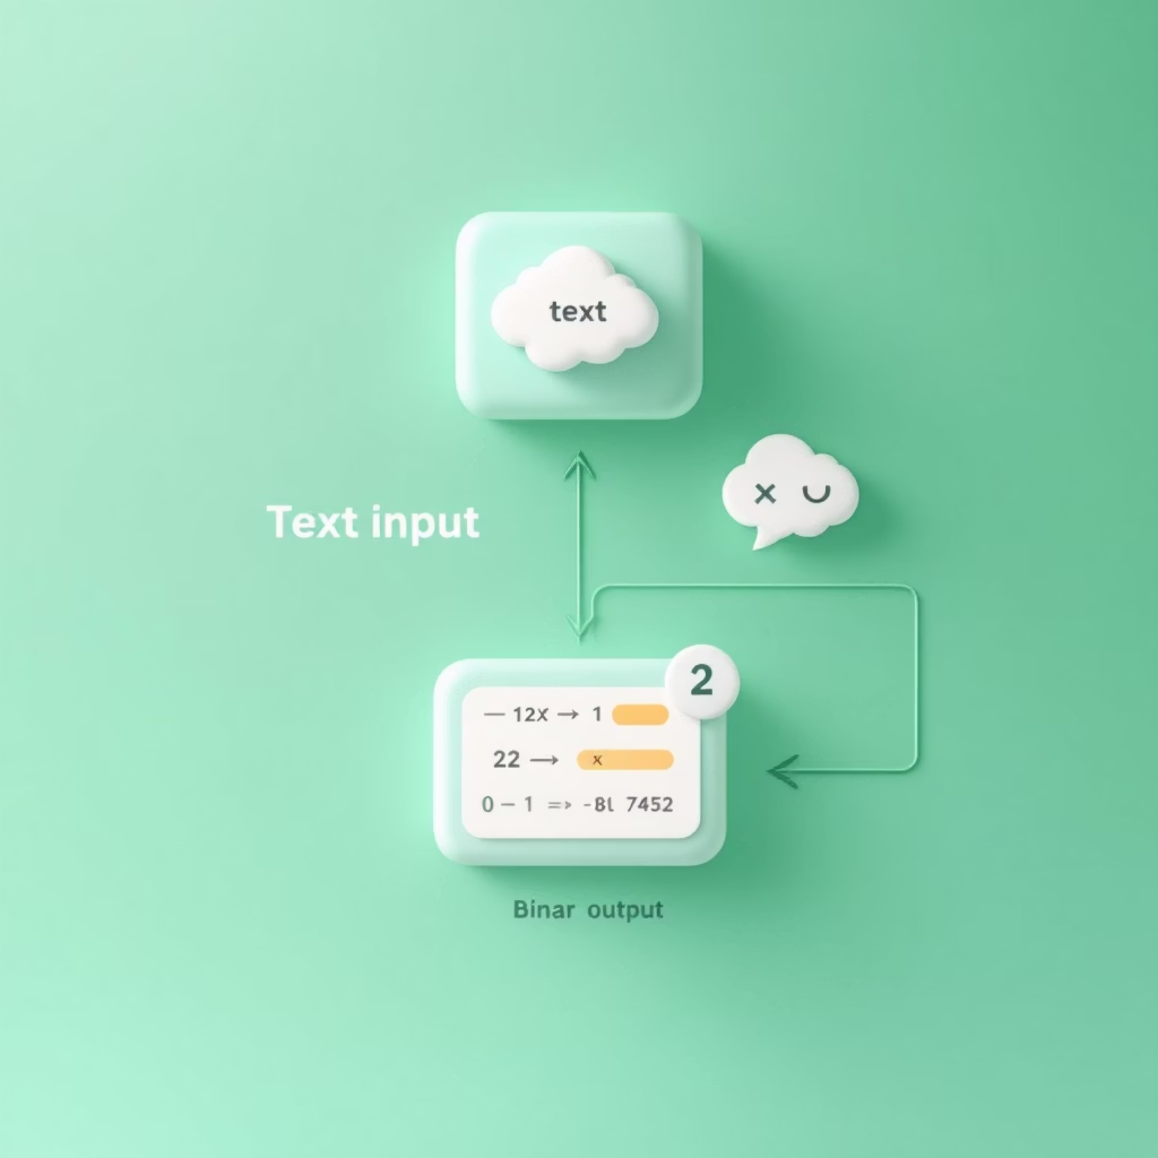

Comment Classification: Logistic Regression at Work
The core of our classification system relies on Logistic Regression, integrated seamlessly into the NLP pipeline. This algorithm is effective for binary classification tasks like distinguishing toxic from non-toxic comments.
Input: Cleaned and TF-IDF vectorized comments.
Prediction: Logistic Regression determines if a comment is Toxic (1) or Non-Toxic (0).
Confidence: Provides probabilities indicating the model's certainty.
While Logistic Regression is applied here as a text classification technique, the overarching focus remains on practical NLP application.

Slide 9

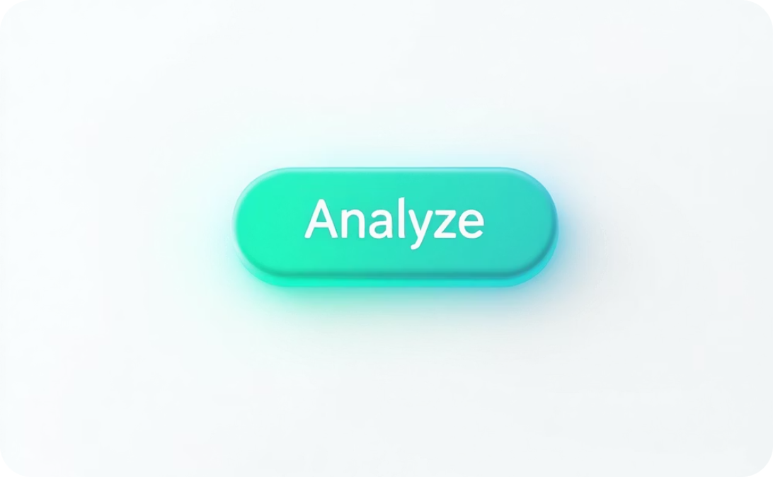
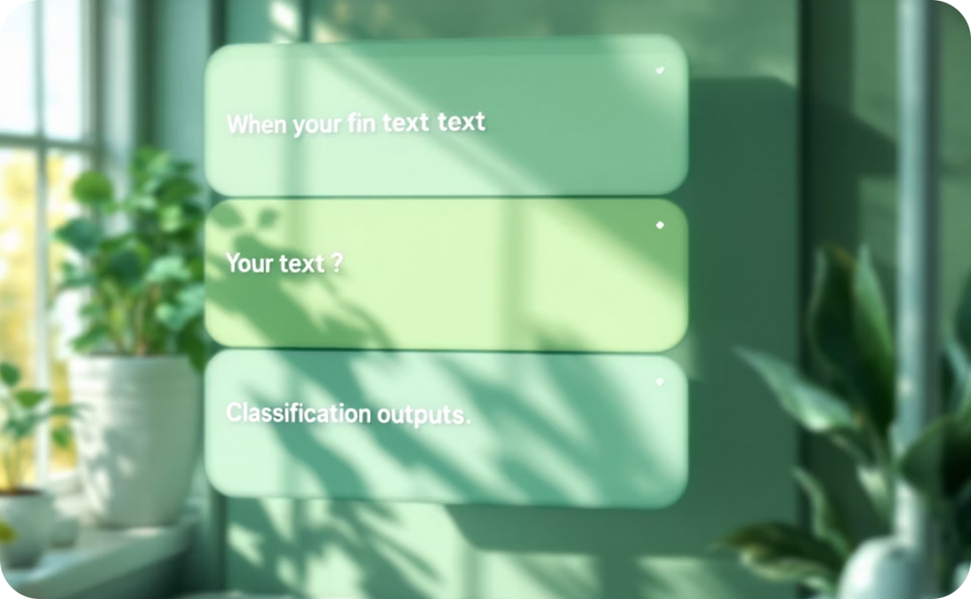
Interactive Web Application with Streamlit
User-Friendly Interface
Real-Time Analysis
Multiple Comment Support
Designed for intuitive interaction, making NLP analysis accessible.
Instantly classifies comments upon user input.
Allows analysis of several comments entered simultaneously, line by line.
The Streamlit application serves as the front-end, enabling users to effortlessly input comments and receive immediate classification results, complete with confidence scores.

Slide 10


Conclusion: Achievements and Future Directions
Key Advantages
Future Improvements
Automated Moderation
Advanced NLP Models
Significantly reduces manual effort in content review.
Integrate deep learning models like BERT for enhanced contextual understanding.
Rapid Analysis
Multilingual Support
Provides fast, real-time results via a web interface.
Expand functionality to classify comments in multiple languages.
Scalable NLP Pipeline
Enhanced UI Visuals
Reusable for various text classification tasks.
Add visual indicators for prediction probabilities and other insights.
User-Friendly
Contextual Understanding
Ideal for demonstrations and practical projects.
Develop methods to better interpret sarcasm and subtle toxicity.

Slide 11
THANK YOU !

